Slide 1


EV CHARGING DEMAND PREDICTION
USING MACHINE LEARNING
Subject : B.Tech Project
Course Code : EE17106
Presented By- Group 3
Chirag Srivastava (20202030)
Shreshtha Gupta (20206050)
Sandeep Oraon (20202072)
Project Supervisor -
Dr. Navneet Kumar Singh

Slide 2
CONTENTS
Motivation
Objective
Literature Survey
Proposed Work and Model
Results
Workplan
References

Slide 3
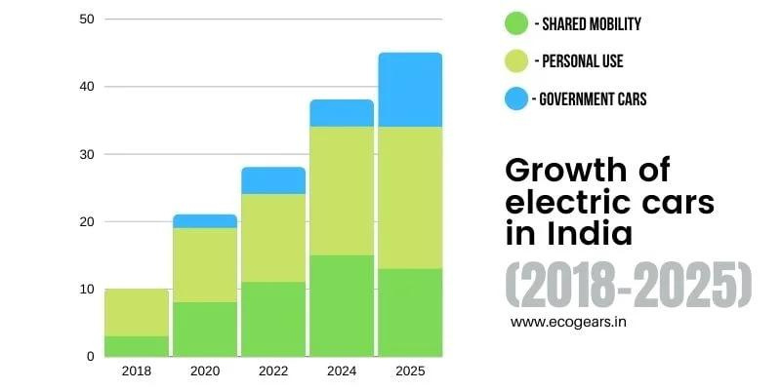
MOTIVATION
The adoption of electric vehicles (EVs) is growing rapidly, driven by environmental concerns and government incentives.

Slide 4
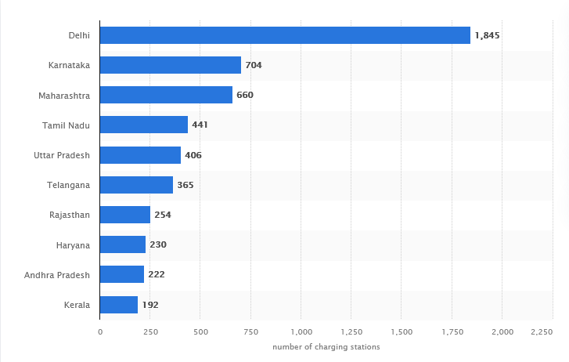
MOTIVATION
To ensure that the grid can meet the growing demand for electricity from EVs, it is important to accurately predict the electricity required for charging EVs at charging stations.

Slide 5
OBJECTIVE
Train a machine learning model on historical data of EV charging sessions and other factors to predict electricity demand at charging stations.
Compare the performance of different machine learning algorithms to identify the best model for predicting electricity demand.

Slide 6
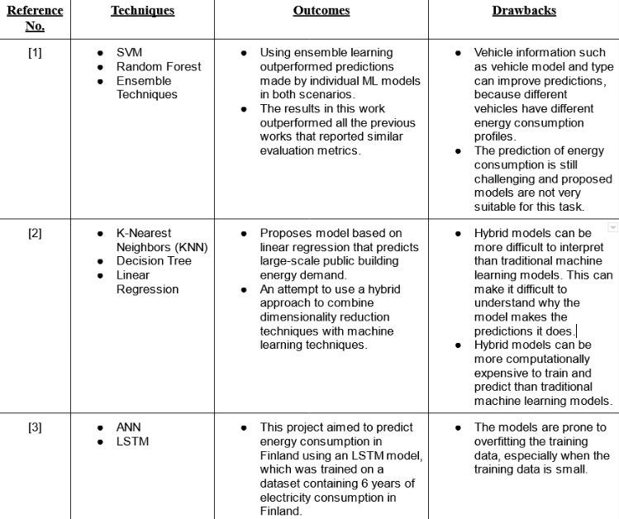
LITERATURE SURVEY

Slide 7
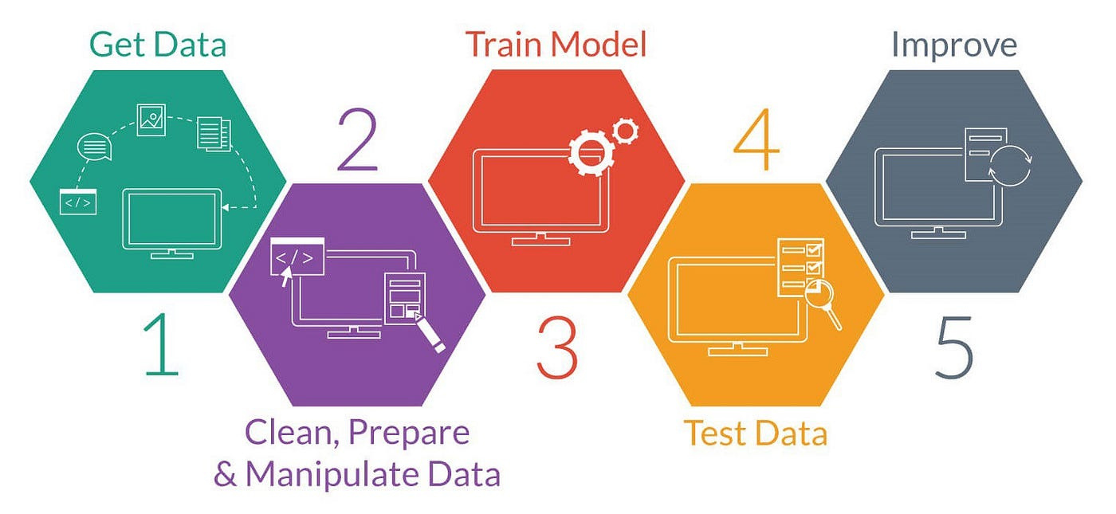
OUTLINE

Slide 8
VARIOUS PREDICTION APPROACHES
We will work on the following approaches:
Classical Machine Learning Algorithms
Deep Learning
Long Short-Term Memory (LSTM)
Transformers
Hybrid Models

Slide 9
Machine Learning Models
Random forest is a popular machine learning algorithm for prediction because it is robust to outliers and can handle non-linear relationships in the data. It is an ensemble learning algorithm, meaning that it combines the predictions of multiple decision trees to produce a final prediction. This makes it less likely to overfit the training data
SVMs can also be used for prediction However, it is important to note that SVMs can be computationally expensive to train on large datasets.
In general, random forest is a more robust and less computationally expensive choice for prediction than SVM.

Slide 10
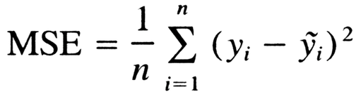
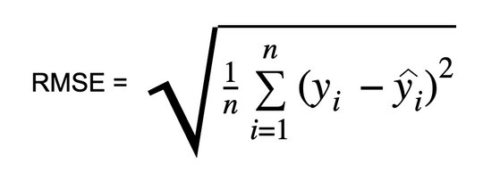
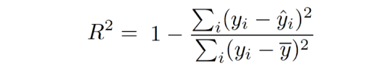
EVALUATION METRICS
The models are evaluated by the following metrics:
Mean Squared Error(MSE):
2. Root Mean Squared Error(RMSE):
3. R Square:

Slide 11
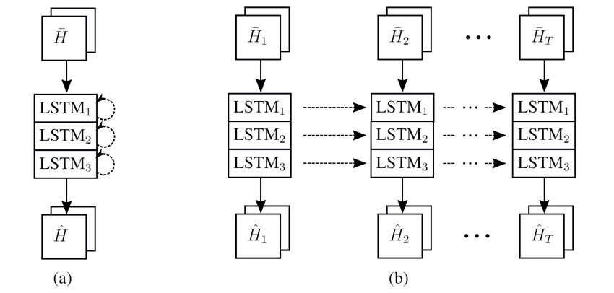
STACKED LSTM
Stacked LSTM was used which contains four hidden LSTM layers one on top of another. The model building starts by creating a sequential model using Keras. Then we added the hidden LSTM layers to the model. Each layer had 50 units. A dropout layer was added to help in preventing overfitting. To update network weights iterative based on training data we used the Adam optimization.

Slide 12
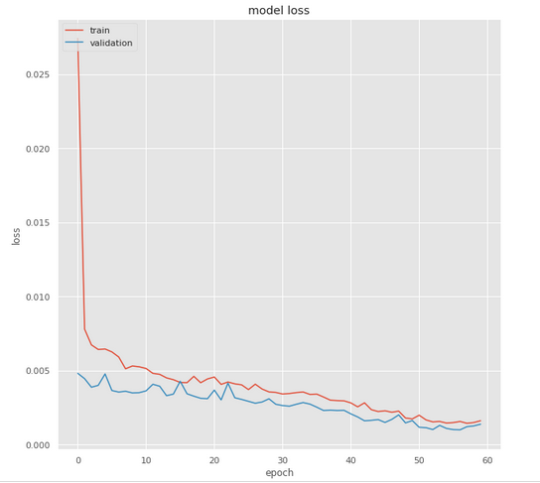
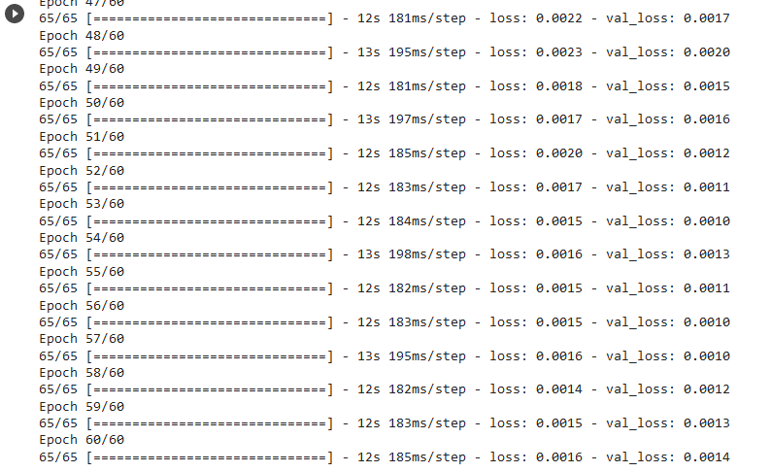
RESULTS

Slide 13
RESULTS
The learning algorithm worked through the entire training dataset 60 times (Epoch), and the model weights were updated after each batch where the batch size is 20.
The check after training was to compare the training loss against the validation loss. The result shows that the two values were low, and no overfitting was detected.
The result has shown good results when applying the stacked LSTM for short-term predictions. The model was tested first on training, validation, and test datasets.

Slide 14
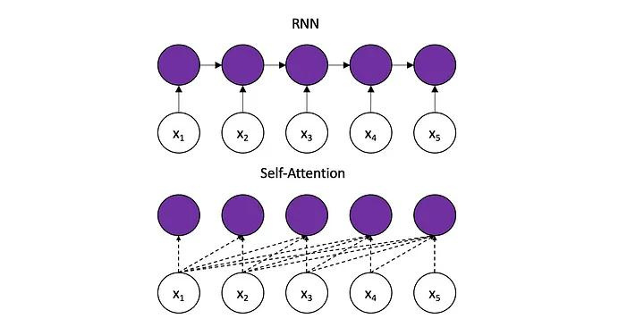
THE SELF-ATTENTION MECHANISM ALLOWS THE NETWORK TO LEARN HOW DIFFERENT PARTS OF THE SEQUENCE ARE RELATED TO EACH OTHER, EVEN IF THOSE PARTS ARE SEPARATED BY MANY TIME STEPS.

Slide 15
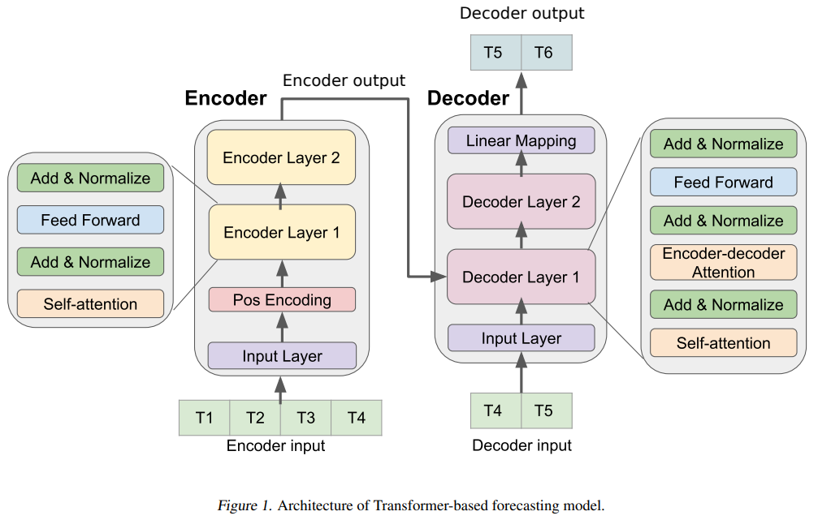
TRANSFORMERS

Slide 16
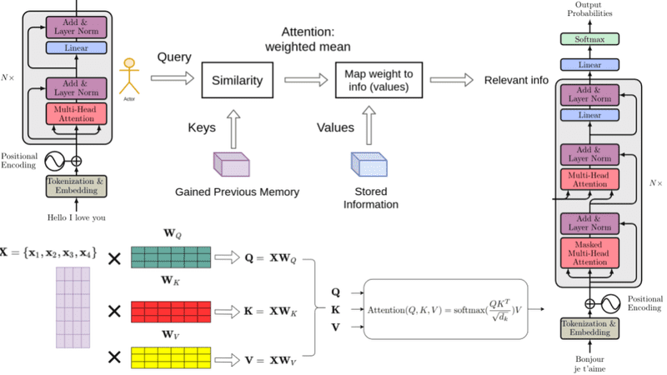
TRANSFORMERS

Slide 17
PROJECT WORK PLAN
AUGUST - NOVEMBER
August: Select a problem statement, read previous works and solutions proposed.
September: Data gathering, exploring, preprocessing and model selections.
October: Training and tune the forecasting models and work exploring advanced modern models.
November: Evaluate and comparing the models and identifying the best solution.

Slide 18
REFERENCES
Prediction of EV Charging Behavior Using Machine Learning by SAKIB SHAHRIAR published August, 2021
Electricity Consumption & Prediction using Machine Learning ModelsArticle · June 2020 by Swati Sucharita Barik and Sasmita Nayak
Z. Xu, ``Forecasting electric vehicle arrival & departure time on UCSDcampus using support vector machines,'' Ph.D. dissertation, Dept. EngSci., Appl. Ocean Sci., UC San Diego, San Diego, CA, USA, 2017.
Agnihotri, N. (n.d.). Classification of machine learning algorithms. Re-trieved from engineersgarage.com: https://www.engineersgarage.com/machine-learning-algorithms-classification

Slide 19
REFERENCES
5. Olah, C. (2015, August 27). Understanding LSTM Networks. Retrieved fromcolah.github.io: https://colah.github.io/posts/2015-08-Understanding-LSTMs/
6. Peixeiro, M. (2019, August 7). The Complete Guide to Time Series Analysis ecastinfromtowardsdatascience.com:https://towardsdatascience.com/the-complete-guide-to-time-series-analysis-
7. M. Majidpour, C. Qiu, P. Chu, R. Gadh, and H. R. Pota, ``Fast prediction forsparse time series: Demand forecast of EV charging stations for cell phoneapplications,'' IEEE Trans. Ind. Informat., vol. 11, no. 1, pp. 242?250,Feb. 2015.

Slide 20
THANK YOU

